Slide 1

AN ONLINE WEB PORTAL ON THE HERITAGE OF DISTRICT NAUSHAHRO FEROZE
Supervisor: Madam Tahira Qadeer Khanzada
Co- Supervisor: Sir Shafique Rehman Panhwar
GROUP MEMBERS:
ZAMEER ALI TUNIO
ASADULLAH PHULL
NASEER ALI SOOMRO
BABAR ALI MALLAH

Slide 2
Introduction
Through Internet, information is easily accessible everywhere in the world.
A competition is increased among institutes, and content creators to advertise their products and services more than any other.
Like tourism is one of key factors for a country to show a positive side of state.
The tourism is fastest growing industry nowadays.

Slide 3
Introduction (cont..)
Website, Portfolio and Portal is better platform to advertise / polish the hidden facts (history, past, present & future etc.) for tourists and locals as well.

Slide 4
Background
Most developed countries have launched their city website to facilitate citizen.
Some of them are mentioned below:
www.xyz.com
When we take a look at Pakistan, we rarely find such websites of any city.
Some of them are mentioned below:
www.apnalarkana.com
www.kmc.gos.pk

Slide 5
Problem Identification
We often see many related issues like misguiding the people.
When we look at District Naushahro Feroze, we usually find very less information.
The UI of above mentioned Pakistani websites is below average.
This web portal facilitate the locals of city to get a particular information resource when needed.

Slide 6
Our Aim
To meet the world's largest broadcasting resources at easy and low cost with attractive UI.
We aim to highlight the heritage of our city Naushahro Feroze in the world view for culture, history, tourism etc.
Keeping these key points in mind, the Idea “An online web portal on the heritage of District Naushahro feroze” is proposed.
A Stranger as well as a local will get all possible information regarding particular Office, Institute, place etc.

Slide 7
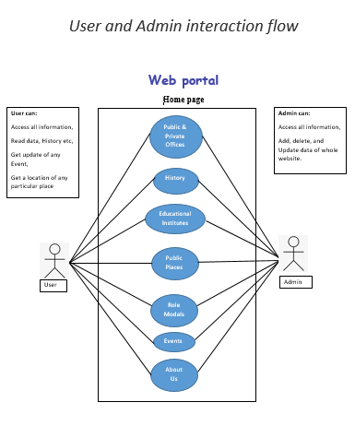
UML chart

Slide 8
Proposed System and Methodology Implementation
When a person (local or Stanger) searches any thing related to Naushahro feroze on Google.
He will see our web portal on his screen.
The system will use some techniques of:
Learning Web Designing, Web Development, their techniques,
Designing UI in Paint. And Adobe XD
Implementing phase 4 using React.js, JavaScript, Bootstrap, HTML & CSS
Firebase Database,
IDE Code VS

Slide 9
Objectives
Shows the other side of District (Culture, traditions, Historical spots etc)
Will be complete guide for new arrivals in Naushahro feroze
Time & money saving.

Slide 10
Conclusion / Future Work
Provide all possible Information will be on a platform.
Can be easily accessed everywhere in the world
This web portal meets the modern standards of development.
Instead of getting static information placed on website, this web portal have Events & latest news webpage.

Slide 11
Conclusion / Future Work (cont..)
In future:
The portal will be launched in Android version.
Further same platform will be used as community app.
Day by day the information will be updated.

Slide 12
Thank you.

